Slide 1

Physics (PHY 102)Thermodynamics
Farjana Yeasmin
Lecturer in Physics, Basic Science Division
World University of Bangladesh, Dhaka-1205

Slide 2

Objectives
Thermodynamics

Slide 3
First law of Thermodynamics-Applications
Isobaric Process
Isochoric process
Isothermal process
An isochoric process is that process which occurs at constant volume. The animation shows a cycle using two constant pressure processes and two constant volume processes. Its representation in a P-V diagram is a rectangle. The rectangle horizontal sides are the isobars and the rectangle vertical sides are the isochoric.
Occurs at a constant temperature, this typically occurs when a system is in contact with an outside thermal reservoir, and the change occurs slowly enough to allow the system to continually adjust to the temperature of the reservoir through heat exchange.
It is a process which occurs at constant pressure. The animation is that of a process whereby the pressure remains constant while temperature and volume vary in a system.

Slide 4
First law of Thermodynamics-Applications
Adiabatic Process
An adiabatic process is one in which no heat is gained or lost by the system. An adiabatic process may be accomplished by thermal insulation or by making rapid changes in volume so that there is no time for heat to be exchanged as shown in the animation.
Limitations of first law of thermodynamics
The limitation of the first law of thermodynamics is that it does not say anything about the direction of flow of heat.
It does not say anything whether the process is a spontaneous process or not.
The reverse process is not possible. In actual practice, the heat doesn’t convert completely into work. If it would have been possible to convert the whole heat into work, then we could drive ships across the ocean by extracting heat from the water of the ocean.

Slide 5
First law of Thermodynamics-Mathematical Problems
1. 3000 J of heat is added to a system and 2500 J of work is done by the system. What is the change in internal energy of the system?
2. 3.0-g bullet traveling at a speed of 400 m/s enters a tree and exits the other side with a speed of 200 m/s. Where did the bullet’s lost kinetic energy go, and how much energy was transferred?
Known :
Heat (Q) = +3000 Joule
Work (W) = +2500 Joule
Wanted: the change in internal energy of the system
Known :
v_{i} = 400 m/s, v_{f} = 200 m/s
K.Ei – K.Ef = ½ m (v_{i}²-v_{f} ²)
Solution :
The equation of the first law of thermodynamics is
Δ U = Q-W
The sign conventions :
Q is positive if the heat added to the system
W is positive if work is done by the system
Q is negative if heat leaves the system
W is negative if work is done on the system
The change in internal energy of the system :
ΔU = 3000-2500
ΔU = 500 Joule
Internal energy increases by 500 Joule.
Solution :
We know that,
K.Ei – K.Ef = ½ m (v_{i}²-v_{f} ²)
= ½ 3x10⁻³ (16-4)x10⁴ J
= 180 J
Try yourself!!!
A 5.00-gm lead bullet traveling at 300 m/s is stopped by a large tree. If half the kinetic energy of the bullet is transformed into internal energy and remains with the bullet while the other half is transmitted to the tree, what is the increase in temperature of the bullet?

Slide 6
Second law of Thermodynamics
The second law of thermodynamics states that heat can flow spontaneously from a hot object to a cold object; heat will not flow spontaneously from a cold object to a hot object.
Carnot engine, heat engine are some examples of second law of thermodynamics.
Entropy!!
It is central to the second law of thermodynamics, which states that in an isolated system any activity increases the entropy.

Slide 7
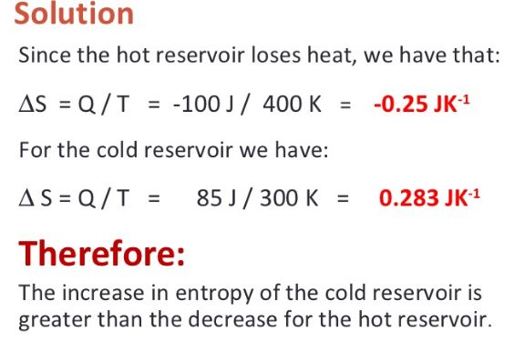
Entropy
Definition:
It is a thermodynamic function of the state of the system or property. It can be interpreted as the amount of order or disorder of the system.
Change in entropy:
The change in entropy $∆S$ of a system when an amount of thermal energy Q is added to a system by a reversible process at constant absolute temperature T is given by
$$∆S= \frac{Q}{T}$$
Example:
A heat engine removes 100 J each cycle from a heat reservoir at 400 K and exhausts 85 J of thermal energy to a reservoir at 300 K. Compute the change in entropy for each reservoir.
Solution:
Therefore, the increase in entropy of the cold reservoir is greater than the decrease for the hot reservoir.

Slide 8
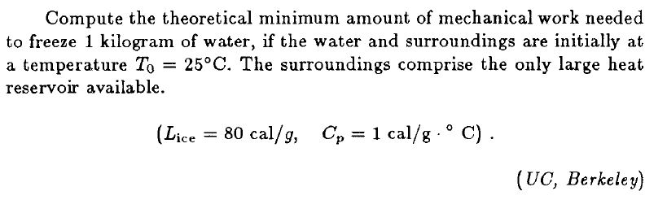
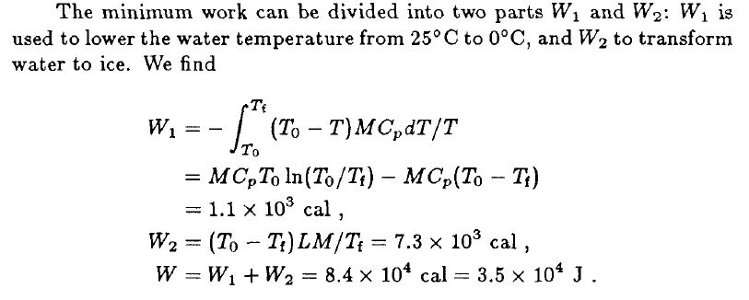
Entropy-Mathematical problem
1.
Solution:

Slide 9
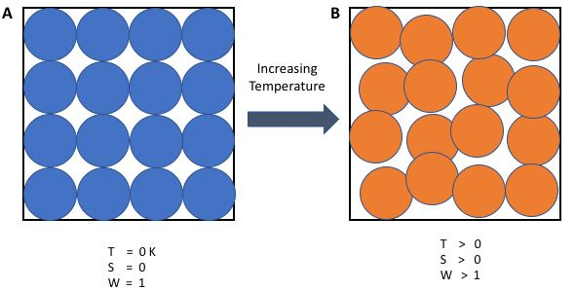
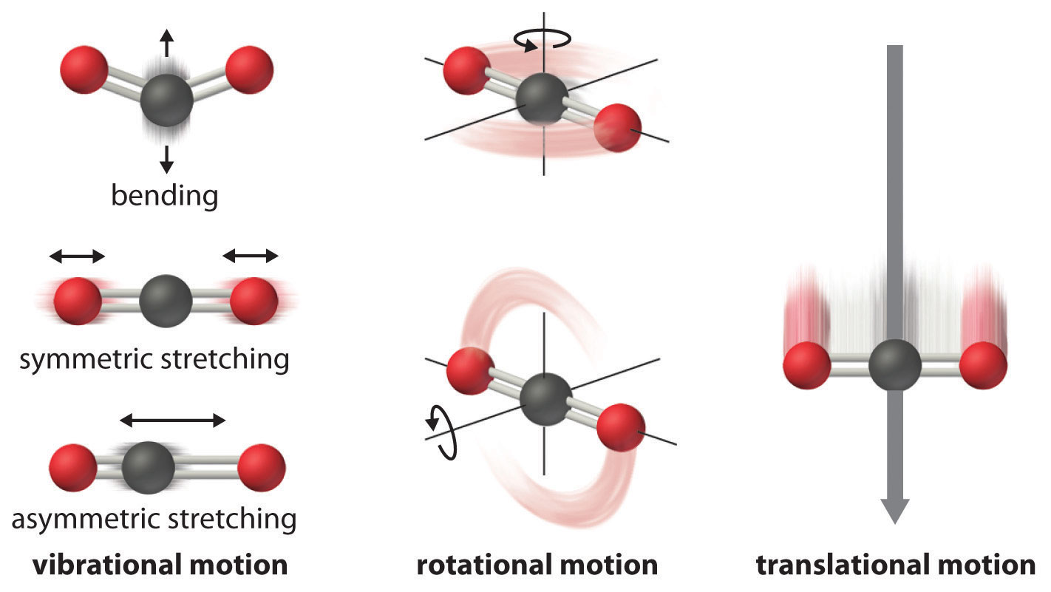

Third law of thermodynamics
The third law of thermodynamics states that the entropy of a perfect crystal at a temperature of zero Kelvin (absolute zero) is equal to zero.

Slide 10
Importance of thermodynamics
What is the application of thermodynamics in civil engineering?
Thermodynamics is a branch of science that explains energy and its transformation based on the physical state of the matter. The analysis of thermal activities is derived by means of energy conservation equations, which are based on the conservation of mass or the conservation of energy.
Thermodynamic principles mainly depend either on the law of conservation of energy or the law of conservation of mass. Law of conservation of mass and energy equations and calculations are thoroughly reviewed in our FE exam review courses.
It is important in some hydrodynamics problems where flows of differing temperatures interact (eg. cold river flowing into a warm saltwater environment). The different temperature not only change the densities of the different flows, but can cause vertical velocities in a area that otherwise might be able to represented by 2D flow
Civil engineers employ thermodynamics in wastewater treatment, especially in the digestion of the collected sludge from the activated sludge process.

Slide 11
Conclusions
Thank you

